Slide 1
بسم الله الرحمن الرحيم

Slide 2
Green Chemistry

Slide 3
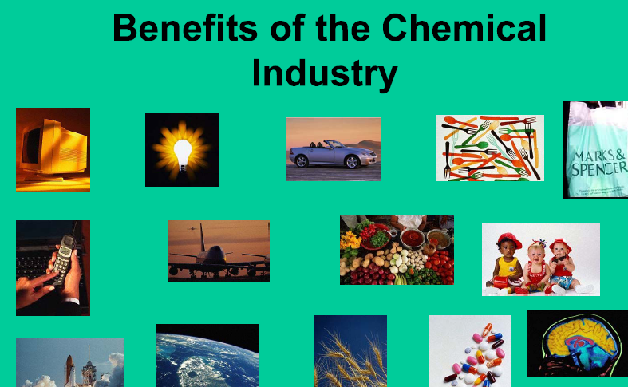
We know the importance of chemical industries in our day-to-day life

Slide 4
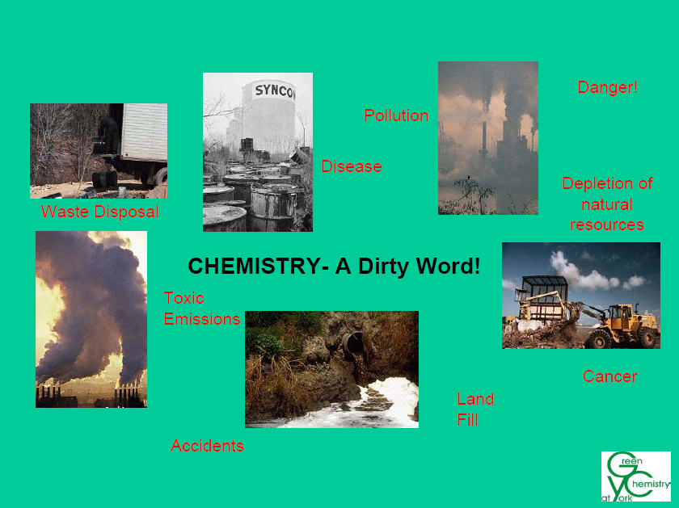
But it is plagued with several problems, such as running out of petrochemical feedstock, environmental issues, toxic discharge, depletion of nonrenewable resources, short-term and long-term health problems

Slide 5
But We know that there is a growing need for more environmentally acceptable processes in the chemical industry. This trend towards what has become known as’
‘Green Chemistry’ or ‘Sustainable Technology

Slide 6
WHAT IS GREEN CHEMISTRY ?
DEFINITION
  Green Chemistry is the utilisation of a set of principles that reduces or eliminates the use or generation of hazardous substances in the design, manufacture and application of chemical products .
  GREEN CHEMISTRY IS ABOUT
  Waste Minimisation at Source
  Use of Catalysts in place of Reagents
  Using Non-Toxic Reagents
  Use of Renewable Resources
  Improved Atom Efficiency
  Use of Solvent Free or Recyclable Environmentally Benign Solvent systems

Slide 7
Green Chemistry Is About...
^{Waste}
^{Materials}
^{Hazard}
Reducing
^{Risk}
Energy
Cost

Slide 8
The 12 Principles of Green Chemistry (1-6)

Slide 9
The 12 Principles of Green Chemistry (7-12)
    7 Use of Renewable Feedstocks
      A raw material or feedstock should be renewable rather than depleting whenever technically and economically practicable.
    8 Reduce Derivatives
      Unnecessary derivatization (use of blocking groups, protection/de-protection, and temporary modification of physical/chemical processes) should be minimised or avoided if possible, because such steps require additional reagents and can generate waste.
    9 Catalysis
      Catalytic reagents (as selective as possible) are superior to stoichiometric reagents.
    10 Design for Degradation
      Chemical products should be designed so that at the end of their function they break down into innocuous degradation products and do not persist in the environment.
    11 Real-time Analysis for Pollution Prevention
      Analytical methodologies need to be further developed to allow for real-time, in-process monitoring and control prior to the formation of hazardous substances.
    12 Inherently Safer Chemistry for Accident Prevention
      Substances and the form of a substance used in a chemical process should be chosen to minimise the potential for chemical accidents, including releases, explosions, and fires.

Slide 10
Key words in 12 principles of Green chemistry

Slide 11
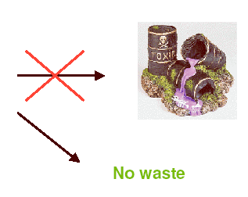
“It is better to prevent waste than to treat or clean up waste after it is formed”
Chemical
Process

Slide 12
The cost of waste
The costs of waste to a chemical manufacturing company are high and diverse and, for the foreseeable future, they will get worse.

Slide 13
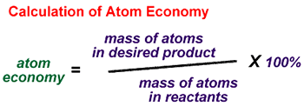
The atom efficiency of the reaction
is one of the most useful tools available for design of reactions with minimum waste. So reactions should be designed to be atom efficient.

Slide 14
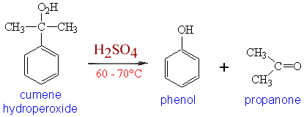
phenol
Chemical process
Green process
the atom efficiency would be 116/260 or 44.6%.
has a 100% atom efficiency and a zero E factor, indicating acompletely waste-free process (assuming 100% yield).

Slide 15
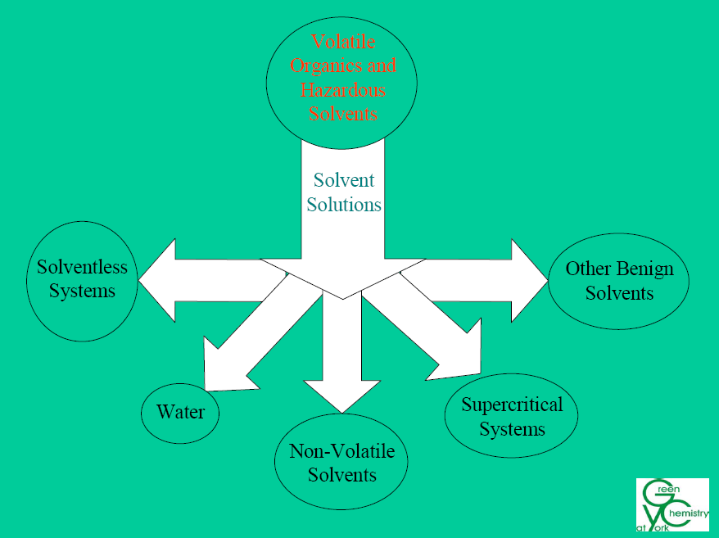
“The use of auxiliary substances (e.g. solvents, separation agents, etc.) should be made unnecessary wherever possible, and innocuous when used”

Slide 16
Why Ethyl lactate Is a Green solvent
Being 100% biodegradable.
Noncorrosive.
Easy to recycle. .
Non carcinogenic.
Non ozone-depleting
SO
it has eliminated the use of chlorinated solvents and replaced solvents such as toluene , acetone, and xylene.

Slide 17
Solvent-Free Conditions
1. There is no reaction media to collect, dispose of, or purify and recycle.
2. On a laboratory’s preparative scale, there is often no need for specialized equipment.
3. Extensive and expensive purification procedures such as chromatography can often be avoided due to the formation of sufficiently pure compounds.
4. Greater selectivity is often observed.
5. Reaction times can be rapid, often with increased yields and lower energy usage.
6. Economic considerations are more advantageous, since cost savings can be associated with the lack of solvents requiring disposal or recycling.

Slide 18
Ionic Liquids
no vapor pressure above the liquid surface.
(nonvolatile) the near-zero vapor pressure.
they do not emit the potentially hazardous volatile organic compounds (VOCs) associated with many industrial solvents during their transportation, handling, and use.
They are nonexplosive and nonoxidizing (nonflammable).
These characterizations could contribute to the development of new reactions and processes that provide significant environmental, safety, and health benefits compared to existing chemical systems.

Slide 19
Carbon Dioxide (CO₂)
Natural, cheap, plentiful (too much of it!)
Available in >99.9% pure form.
By-product of brewing, ammonia synthesis, combustion
Non-toxic and properties well understood
Non-flammable
Easily removed and recycled, and can be disposed of with no net increase in global CO₂

Slide 20
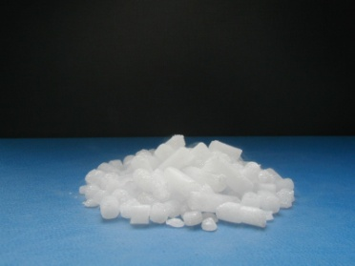
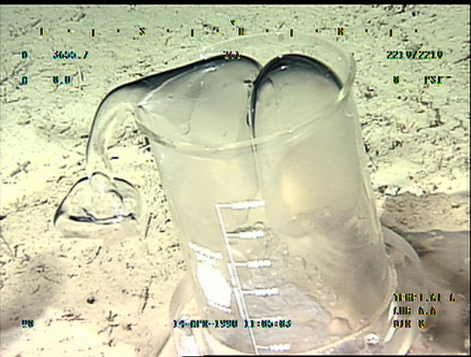
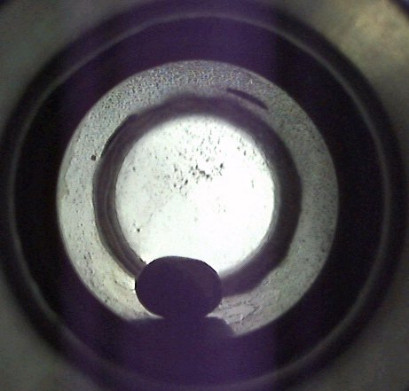
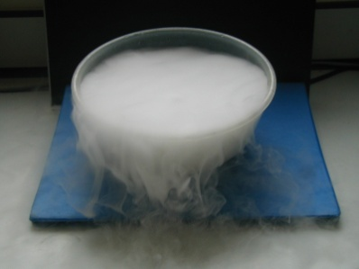
Phase diagram for pure CO₂
© Monterey Bay Aquarium Research Institute
SOLID
SUPERCRITICAL
Critical
•
FLUID
Pressure (bar)
point
74
LIQUID
Triple
•
point
5.1
GAS
1
-78 ºC
-56.3ºC
31.1ºC
Temperature (ºC)

Slide 21
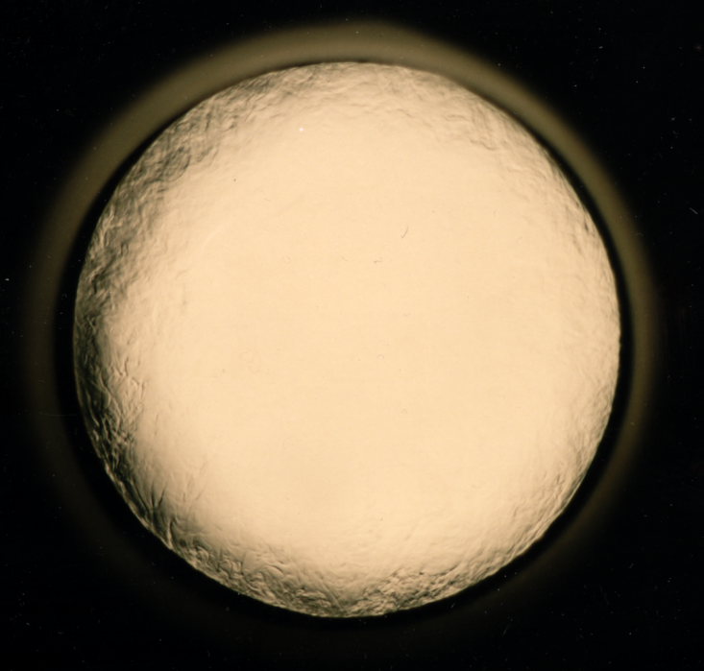
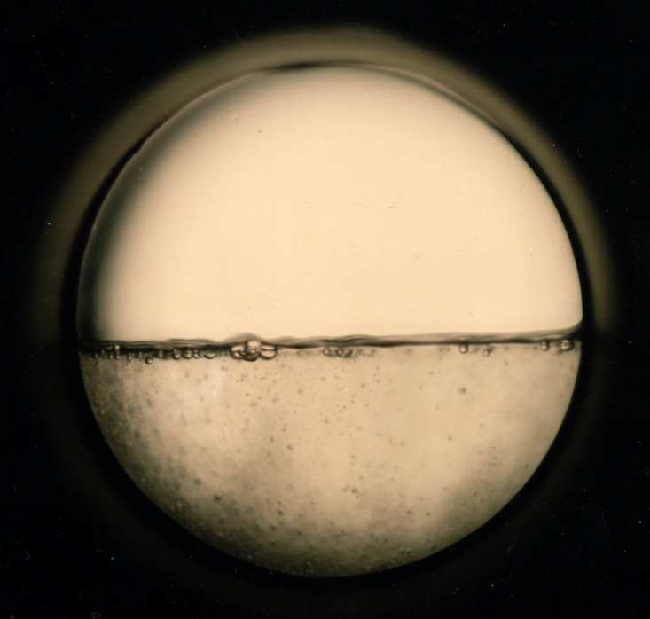
SOLID
SUPERCRITICAL
FLUID
Critical
•
Pressure (bar)
point
74
LIQUID
•
GAS
Triple
point
Temperature (K)
303

Slide 22
Dry Cleaning using ScCO₂
Current methods use perchloroethylene
  Hazardous air pollutant and suspected carcinogen
  Contaminates drinking water supplies
  Contributes to photochemical smog
  <5% recycled
  Requires heating to remove solvent residues
  Characteristic odour
Notes:
Poly(ether-carbonate) coplymers derived from propylene oxide and CO2.

Slide 23
Dry Cleaning using ScCO₂
    New process uses liquid CO₂
    Requires surfactant (recycled)
    No unpleasant odours
    No heat required for drying – energy efficient and kinder on clothes
J.L. Kendall, D.A. Canelas, J.L. Young and J.M. DeSimone,
Chem. Rev., 1999, 99, 2663.
T. Sarbu, T. Styranec and E.J. Beckman,
Nature, 2000, 405, 165.

Slide 24
Green chemistry applied on industerial

Slide 25
Polyurethanes
Traditionally
Phosgene is an extremely toxic and lethal gas.
alternate method
decreases the greenhouse gas but also eliminates the use of dangerous and toxic chemicals

Slide 26
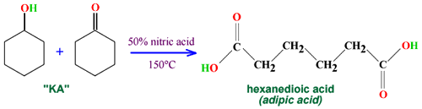
Adipic Acid
Hexanedioic acid (commonly called adipic acid) is first made from Ketone-Alcohol ( KA) using nitric acid
Disadvantage
N₂O has a "greenhouse" effect in the atmosphere, which is over 200 times as strong as carbon dioxide
N₂O is involved in several reactions responsible for the thinning of the ozone layer⁽⁶⁾

Slide 27
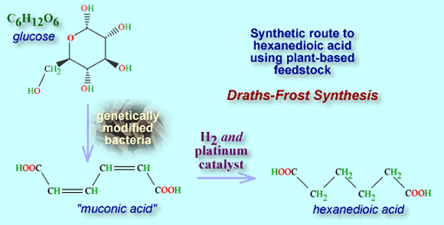
Alternative feedstock in the synthesis of adipic acid is D glucose,which is converted to cis muconic acid using E. coli, which is further hydrogenated to adipic acid using hydrogen gas
This approach eliminates several reaction and separation steps

Slide 28
Herbicides
Disadvantages :
Hydrogen cyanide is extremely toxic, and its use requires special handling to minimize risk to workers, the community, and the environment.
Ammonia and formaldehyde are also associated with human health problems and environmental hazards.
The process produces 1 kg waste for every 7 kg product. The waste contains cyanide and formaldehyde, which need to be treated prior to safe disposal.

Slide 29
The new Monsanto process makes use of a copper catalyst, which is used to reduce diethanol amine to DSIDA, the intermediate to Roundup
Advantages :
eliminates the use of ammonia, hydrogen cyanide, and formaldehyde,
is free of contaminants and by-products

Slide 30
does not require further purification steps
The stream can be recycled after filtration of catalyst.
can be used in the production of other amino acids such as glycine through reduction
is a general method for conversion of primary alcohols to carboxylic acid salts.
.

Slide 31
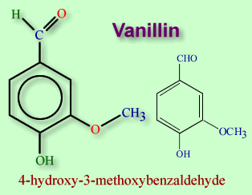


The Food and Flavor Industry
Vanillin is a flavoring agent used in syrups, ice cream, and other edible products
used to manufacture vanillin from o-nitro chlorobenzene

Slide 32
Disadvantages :
. The process produced toxic chemicals,
three to five different tars,
high CODs,
high VOCs,
high health and safety risks,
unacceptable standards for a flavoring product.
The plant dumped untreated effluents into a nearby river, and toxic tars were stockpiled in unmonitored landfills.

Slide 33
The process was modified so that it is now based on the catechol route . This process does not produce any waste and uses several heterogeneous catalysts
Catechol is generally made from phenol. This is a purely petrochemical route.

Slide 34





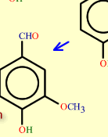
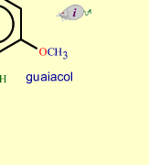

Dr. Karen M. Draths and Professor John W. Frost of Michigan State University developing a range of synthetic routes from plant-derived glucose. They used genetically modified bacteria, which operated in aqueous solution at relatively low temperatures. The modified bacteria produce catechol via two other intermediates..

Slide 35
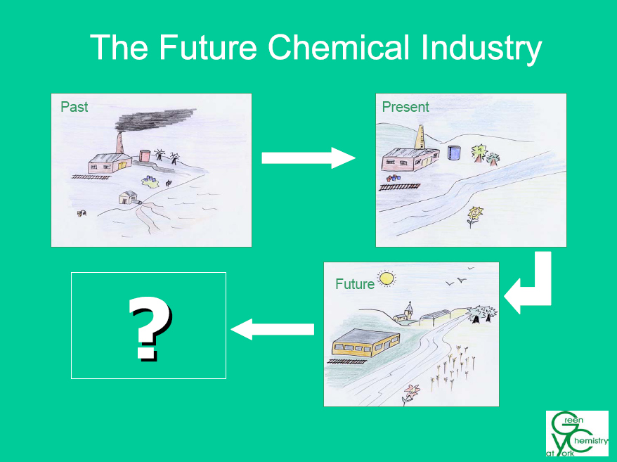

Slide 36
Conclusion
Green chemistry Not a solution to all environmental problems But the most fundamental approach to preventing pollution.

Slide 37
Thank you

